Slide 1

VOP/ Vowel Region Detection And Using It FOR EMOTION RECOGNITION
ARYAN AGARWAL (2018102024)
UTKARSH MISHRA (2018102020)

Slide 2
Contents :
Introduction to VOP and Vowel regions.
Steps to detect VOPs
Vowel regions from VOP
The Emotion Recognition Model
Technologies used in the project
Results
Conclusion
References

Slide 3
Introduction to VOP and Vowel regions.
Vowel onset point (VOP) is the instant at which the onset of vowel takes place in the speech signal.
Similarly, vowel offset point is the instant at which end of vowel takes place in the speech signal.
The region where a vowel occurs in a speech signal is called Vowel region. This is the region present between consecutive vowel onset point and offset point.

Slide 4
Why use Vowel regions for emotion recognition?
Introduction to VOP and Vowel regions.
Vowel regions are voiced part of a speech and hence contain information about vocal tract system.
VOP is an instant that observes significant changes in excitation source and spectral energies.
We believe that Vowel regions play an important role in emotion recognition as those are voiced regions and in a way represent vocal tract system of the speaker.

Slide 5


STEPS to Detect VOP
First, we divided the signal into frames of size 20ms, used a shift of 10ms and performed framewise computation which involves –
1. Computation of pre-emphasized signal followed by low pass filtering (threshold = 2500 Hz).
2. Calculation of LP residual signal, which is the difference of the original signal and the LP signal (linearly predicted signal) with LP order (p) as 8. We also call this as the error signal.
3. Next, we calculated the analytic signal which is: where e_{h}(n) is the Hilbert transform of the LP residual.
4. Lastly, we compute the Hilbert envelope of analytic signal given by:

Slide 6
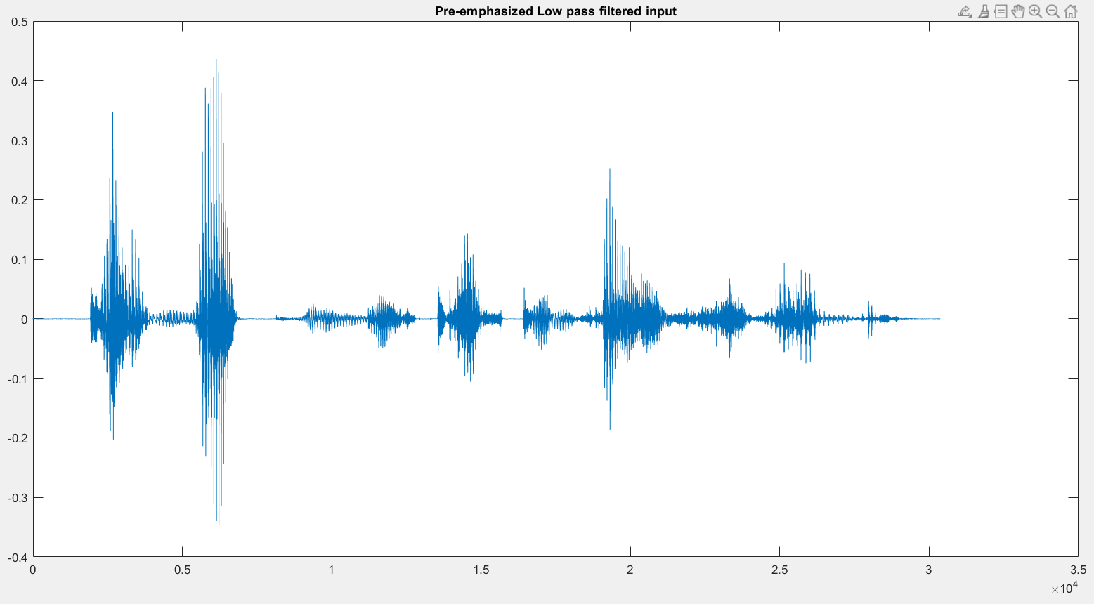
STEPS TO DETECT VOPs

Slide 7
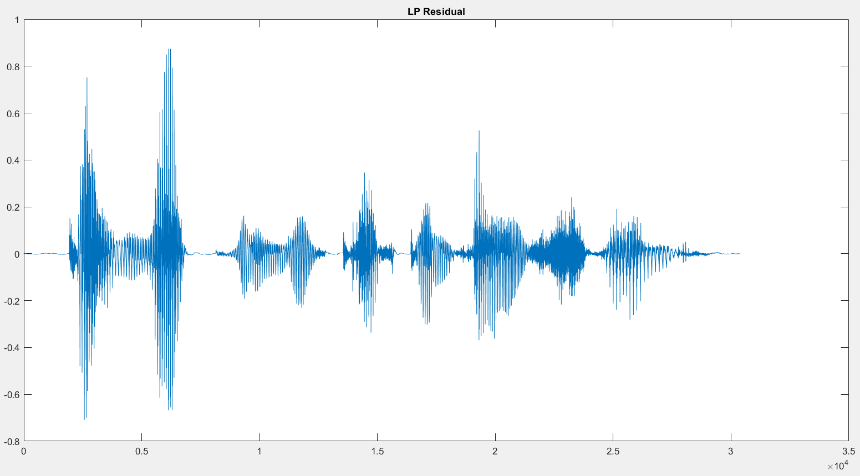
STEPS TO DETECT VOPs​

Slide 8
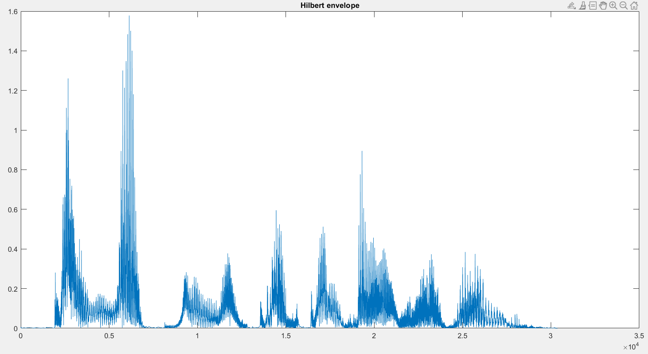
STEPS TO DETECT VOPs​

Slide 9
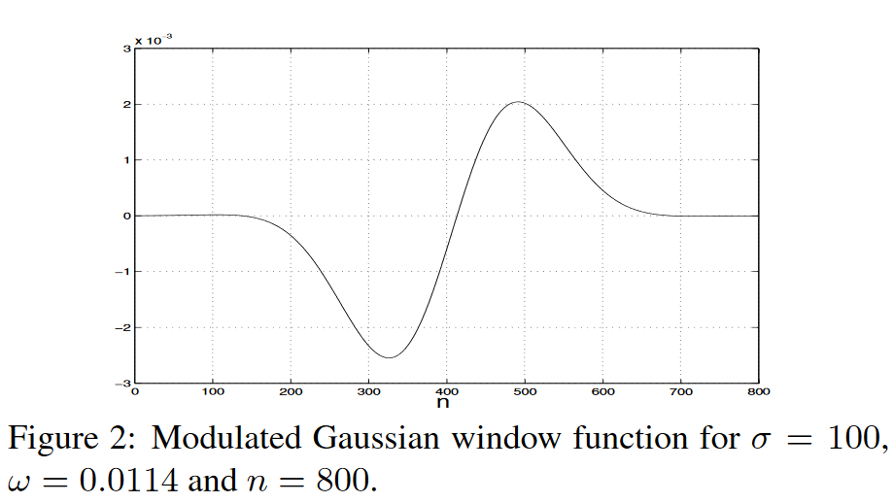
STEPS TO DETECT VOPs
Next, we convoluted the signal obtained (the envelope) with the negative of the modulated gaussian window, which is shown below, output of which is shown in next slide:

Slide 10
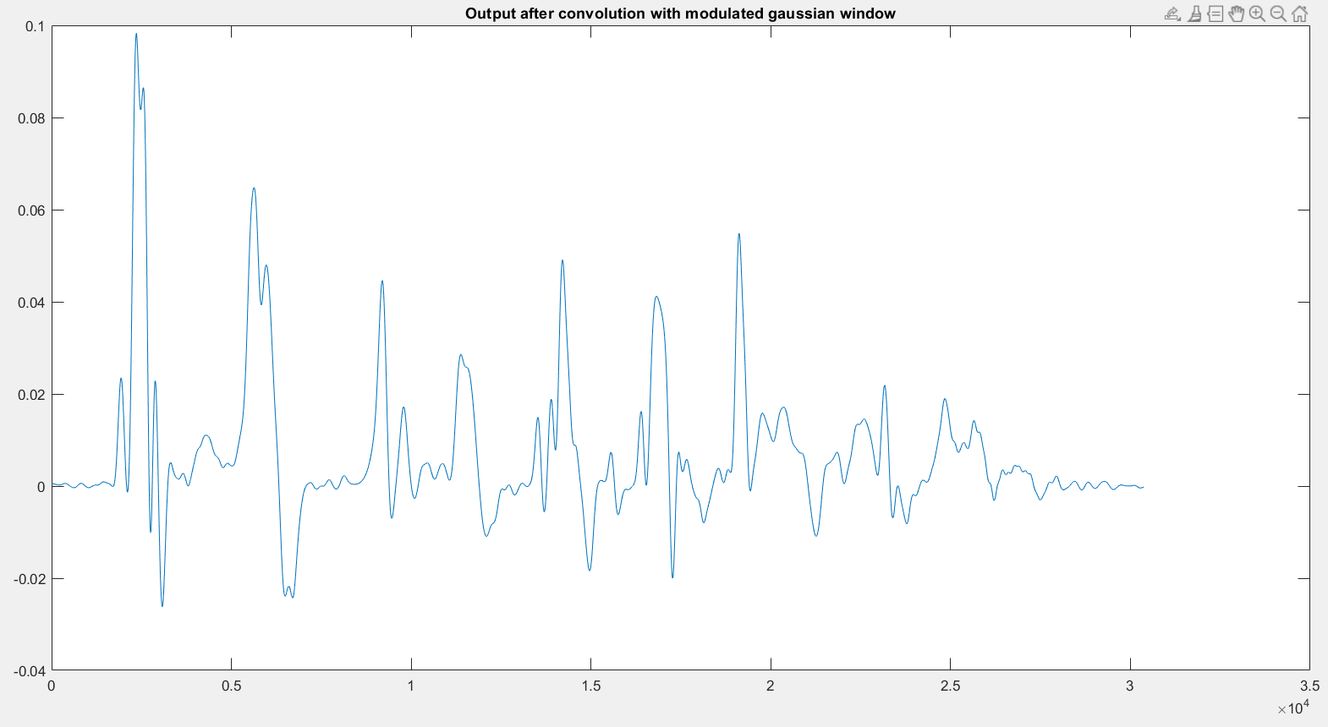
STEPS TO DETECT VOPs​

Slide 11
STEPS TO DETECT VOPs
Then we found out all the local MAXIMAs and local MINIMAs, next to those MAXIMAs in the final graph. As we know, these local MAXIMAs are the VOPs with some spurious peaks.
We then used a threshold and finally we were able to remove many spurious peaks. Thus we found the Vowel Onset points accurately.

Slide 12
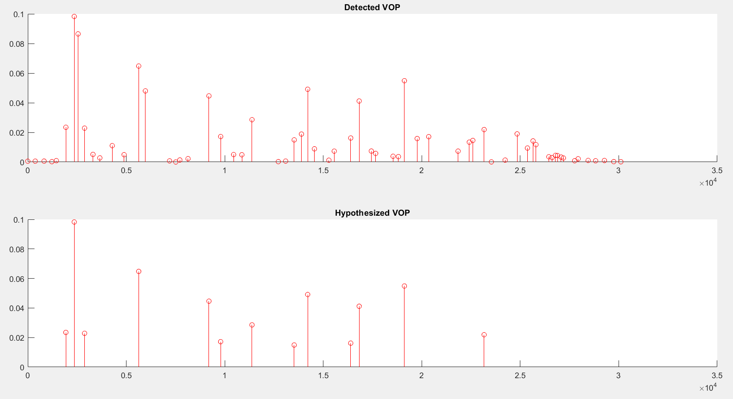
STEPS TO DETECT VOPs​​

Slide 13
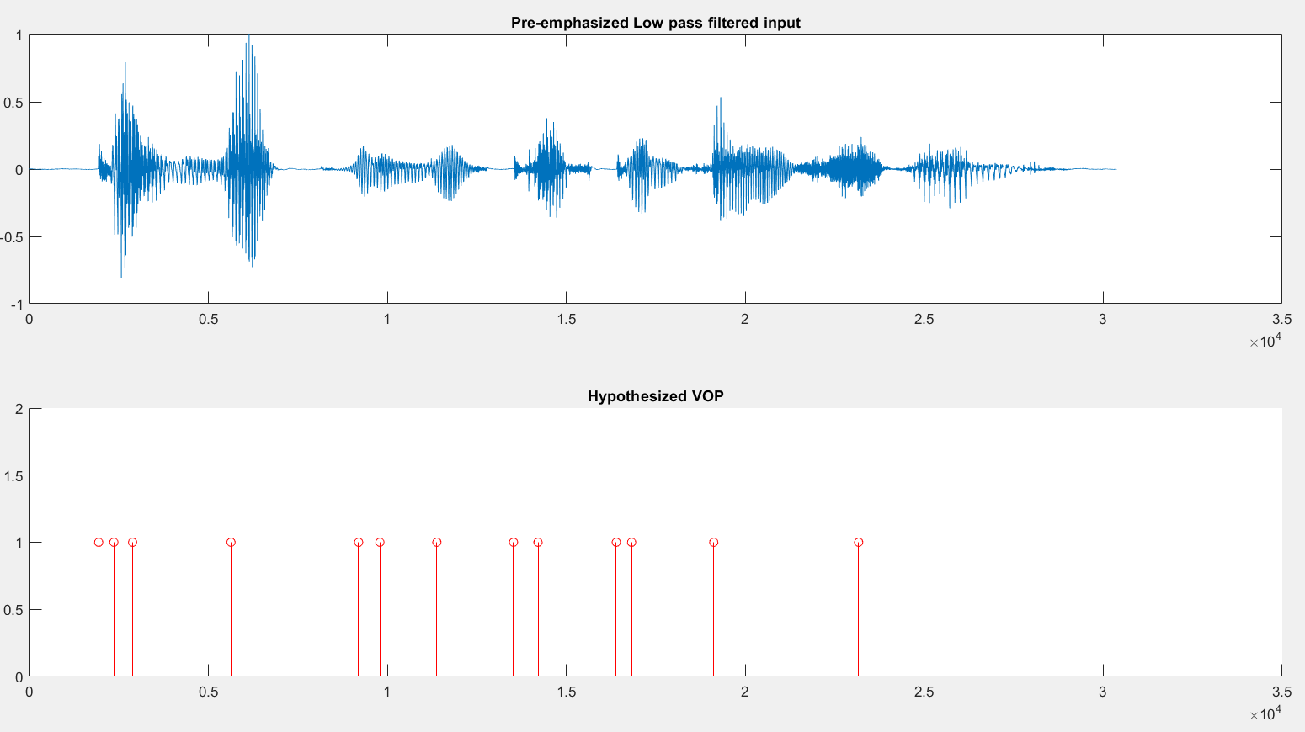
STEPS TO DETECT VOPs​​

Slide 14
VOP Detection accuracy
STEPS TO DETECT VOPs​​
After running the VOP detection model on a file from the database we got
VOP DETECTION MODEL | VOP DETECTION ACCURACY | MISSING RATE
 | 80.95% | 19.05%

Slide 15
Vowel regions from vop
We got Vowel Onset Points and then we chose the vowel region as 80ms region after the VOP.
The reason behind this was that this 80ms included 20ms CV region (Consonant -Vowel), 40ms steady vowel region and 20ms consonant region.

Slide 16
The emotion Recognition model
First, we extracted features such as MFCC, Spectral Sub-band Centroids, etc for each 20ms frame. Then we calculated 7 features : mean, variance, maximum, minimum, and many more for each MFCC value for whole audio. So now each dimension of each feature of the audio is represented by these 7 features.
Then we dumped all this data in a .pkl file with their corresponding emotion label.
Then we normalized the whole data and split it into training and testing data.
Then we did feature selection to reduce the number of computations to train the model. We did this using Boruta.

Slide 17
The Emotion Recognition Model
Then we did data resampling to improve accuracy.
Then we built a rbf-kernel SVM. Then we used Bagging Classifier to get the best classifier.
We used a one vs rest classifier
Then we trained the model and tested the model.

Slide 18
Technologies used in the project
We have detected VOP and vowel regions in MATLAB.
Then we made text files from MATLAB that contained VOP time stamps for each audio.
We have made our ML model in Python which is using VOP from the text files that we made.

Slide 19
Results
We did a comparative study.
Emotion Recognition Model – 1 (ERM-1) is the model that has 80 percent of wav files as training set and rest 20 percent of wav files as testing set.
Emotion Recognition Model – 2 (ERM-2) is the model that has 80 percent of wav files and their corresponding vowel regions as training set and rest 20 percent (wav files only) as testing set.
Emotion Recognition Model – 3 (ERM-3) is the model that only has vowel regions of 80 percent of wav files as training set and rest 20 percent (wav files only) as testing set.

Slide 20
Results
We varied the number of MFCC features also extracted to get different accuracies.
Also, in the confusion matrix and the report shown in the next slides :
0 indicates Anger
1 indicates Boredom
2 indicates Disgust
3 indicates Anxiety/ Fear
4 indicates Happiness
5 indicates Sadness
6 indicates Neutral
The same order is followed in the confusion matrix, where the row i indicates actual files of emotion i and column j shows files that have been predicted as emotion j.

Slide 21
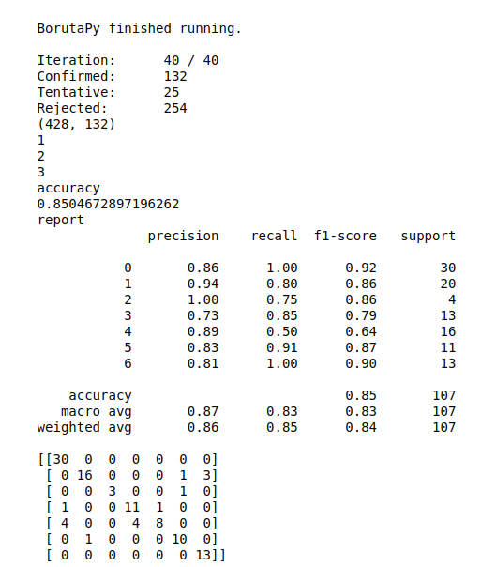
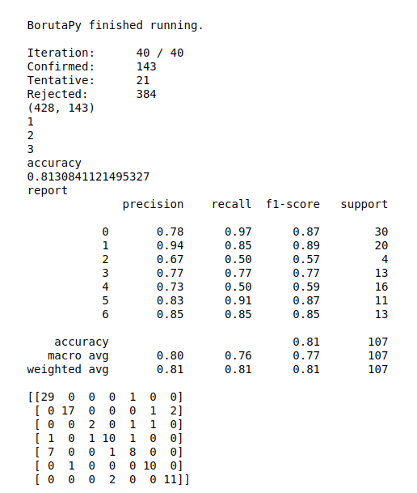
ERM-1
Results
13 MFCC
21 MFCC

Slide 22
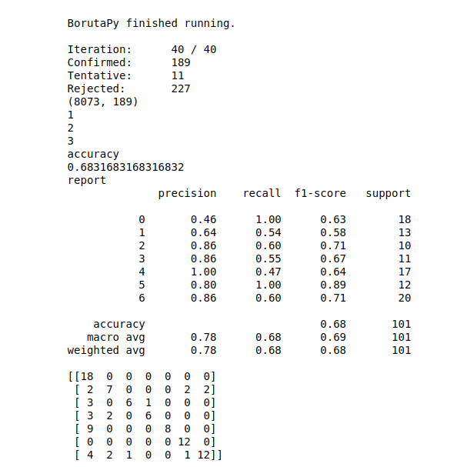
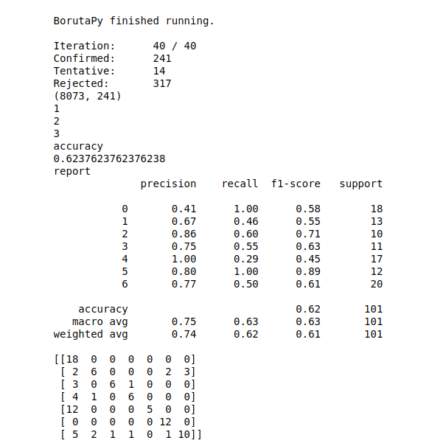
ERM-2
Results
13 MFCC​
21 MFCC

Slide 23
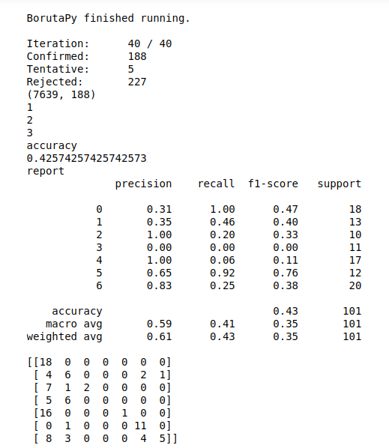
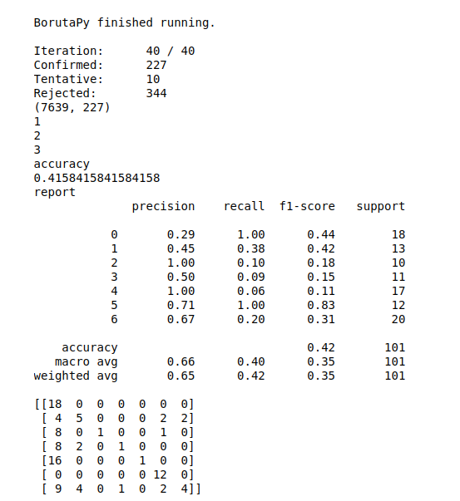
ERM-3
Results
13 MFCC​
21 MFCC

Slide 24
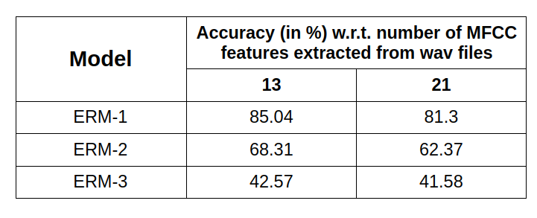
Comparative results
Results

Slide 25
Conclusion
We see that the model works better if only wav files are used for training (without vowel regions). The reason behind this could be losing some information that wav files had but vowel regions didn’t.
The results that we got are comparable with the results from one of the papers that we referred, although they used GMMs, we used kernel-SVMs.
Thus we built a decent ML model that detects emotion of a wav file using features extracted from their vowel regions.

Slide 26
References-
https://www.isca-speech.org/archive/archive_papers/interspeech_2005/i05_1133.pdf
http://emodb.bilderbar.info/docu/?fbclid=IwAR3V4xYLMQ7VrJ6evHzhgAENequPYWqGd8U3GfpSlUg4Hc_M3wsQb1GsXtU
https://ieeexplore.ieee.org/document/5712728
https://www.sciencedirect.com/science/article/abs/pii/S1434841111003207
https://scikit-learn.org/stable/modules/svm.html
https://dhirajkumarblog.medium.com/top-4-advantages-and-disadvantages-of-support-vector-machine-or-svm-a3c06a2b107

Slide 27

THANK YOU!

